Slide 1
Many Waters Riparian Restoration on Spring Creeks in an Urban Landscape

Slide 2
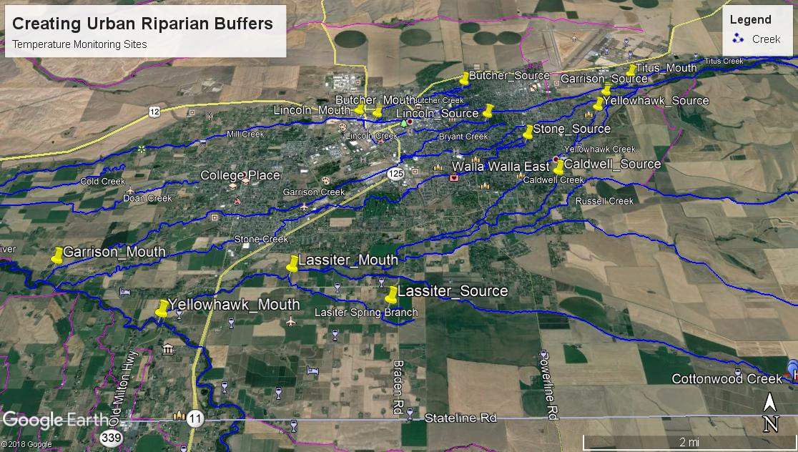

Slide 3
Creating Urban Riparian Buffers (CURB) Walla Walla County Conservation District Tri-State Steelheaders Kooskooskie Commons
Over 80 riparian restoration projects between 2007 and 2015
Buffer width 15 to 35 feet width
2016 new buffer criteria 50/75 ft on salmonid streams ended CURB
Kooskooskie Commons focus-urban/ agricultural properties

Slide 4
Considerations for selecting riparian restoration projects in urban landscapes
Landowner commitment to maintain restoration-signed contract
Landowner criteria-everyone wants to see their creek
Plant selection and layout
Pets and child safety
Problems with weed barrier cloth

Slide 5
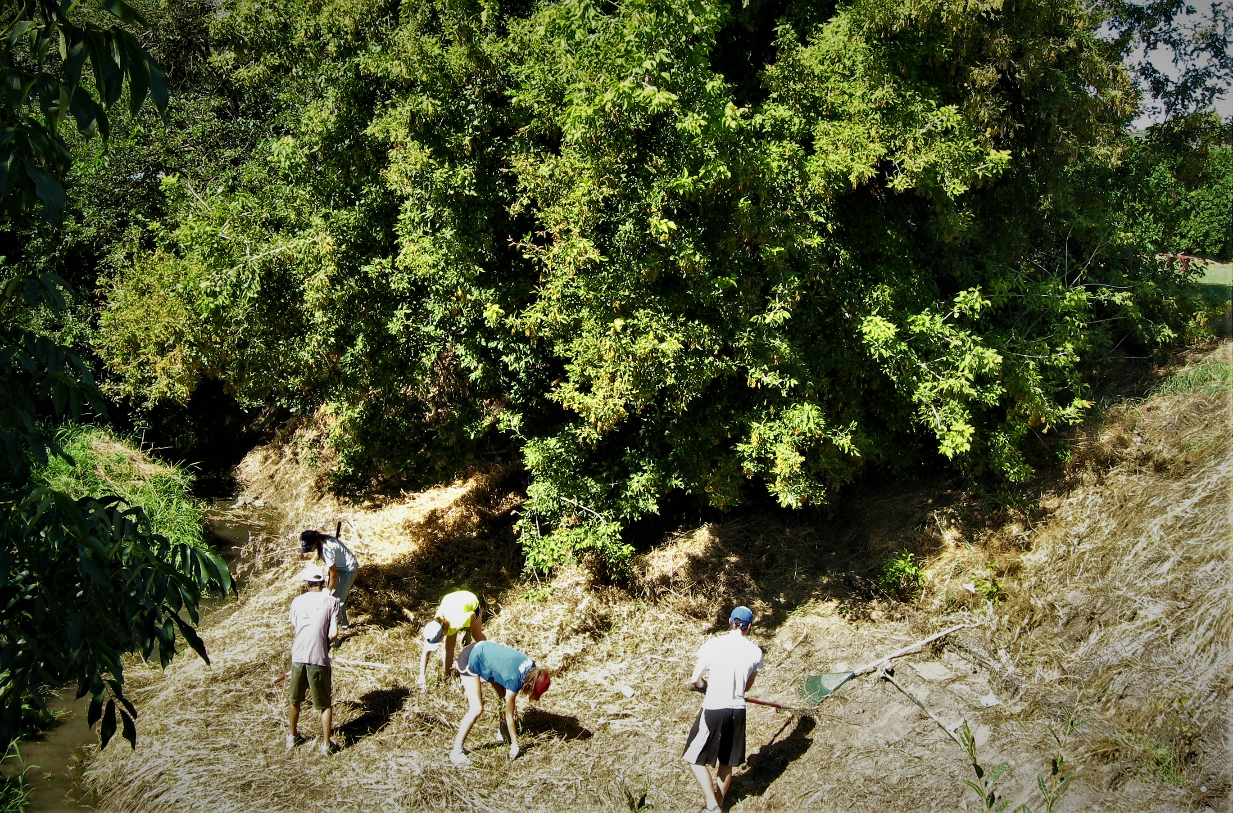
Whitman College Volunteers

Slide 6
Advantages and disadvantages of implementing riparian restoration projects with volunteers.
Creates a learning environment
Community Outreach
Inexpensive
Limited availability
Requires more supervision/must supply tools

Slide 7
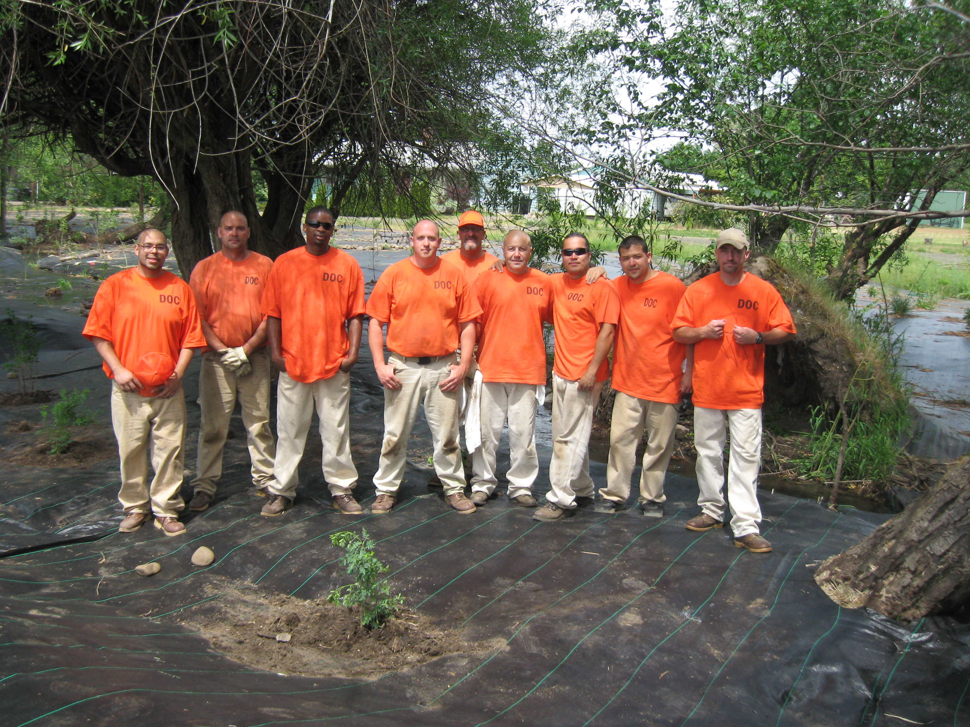
WADOC
Crew

Slide 8
Advantages and disadvantages of implementing riparian restoration projects with WA Department of Corrections Crews
Reliable numbers of men for set scheduled hours
Provide equipment and supervisor
Opportunity to train men for successive projects
Rewarding for inmates to experience well implemented project
Concerns of landowners and neighbors
Potential for drug busts and loss of crew members
Opportunities for crew members after release

Slide 9
Companion Projects Garrison Creek
Companion projects
Large property that in part included both sides of creek over come with blackberries and reed canary grass.
Buffer width averaged more than 50 ft
Property included wetland area and arid areas.
Property owner across creek asked to include their property.
Buffer averaged 25 ft
Both signed contracts to maintain plantings and inform future owners if property sold.

Slide 10
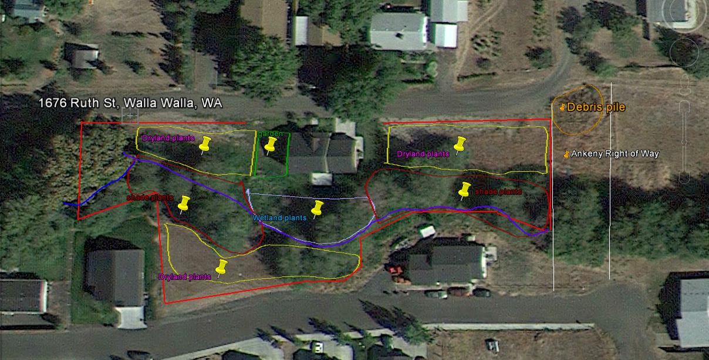

Slide 11
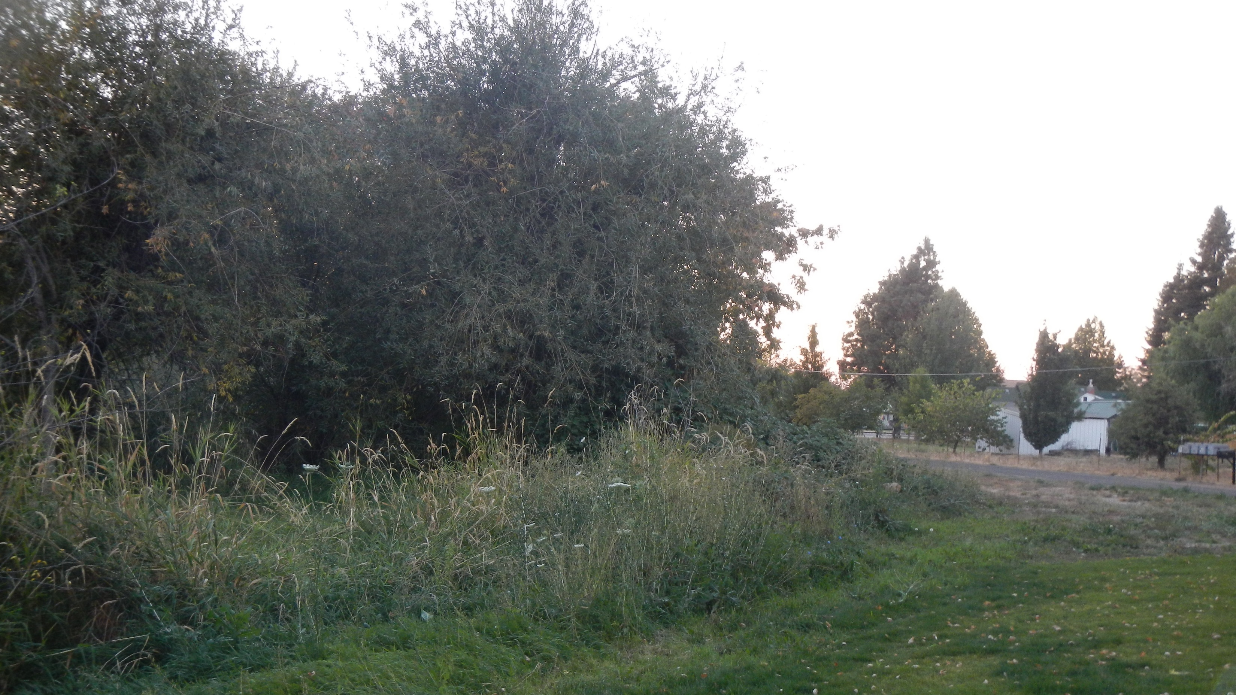
Garrison A
Area 1 Before

Slide 12
Garrison A
Area 1 After

Slide 13
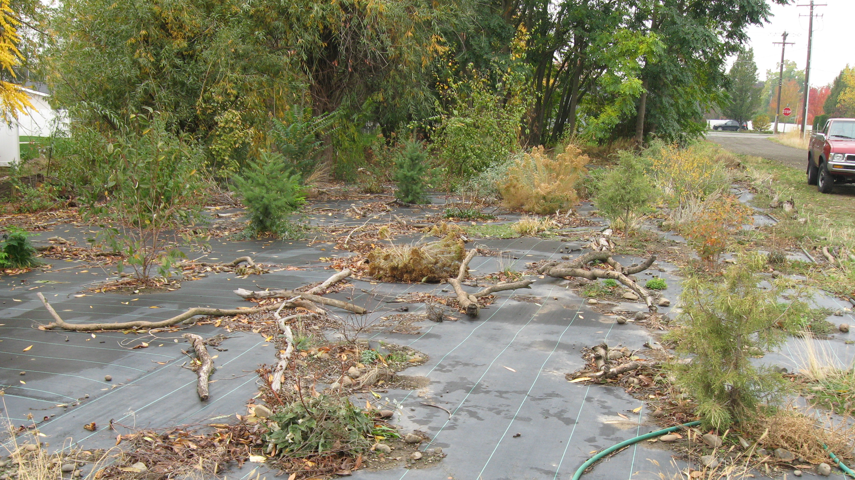
Area 1 After

Slide 14
Area 1 after planting
Garrison A
Area 1 After

Slide 15
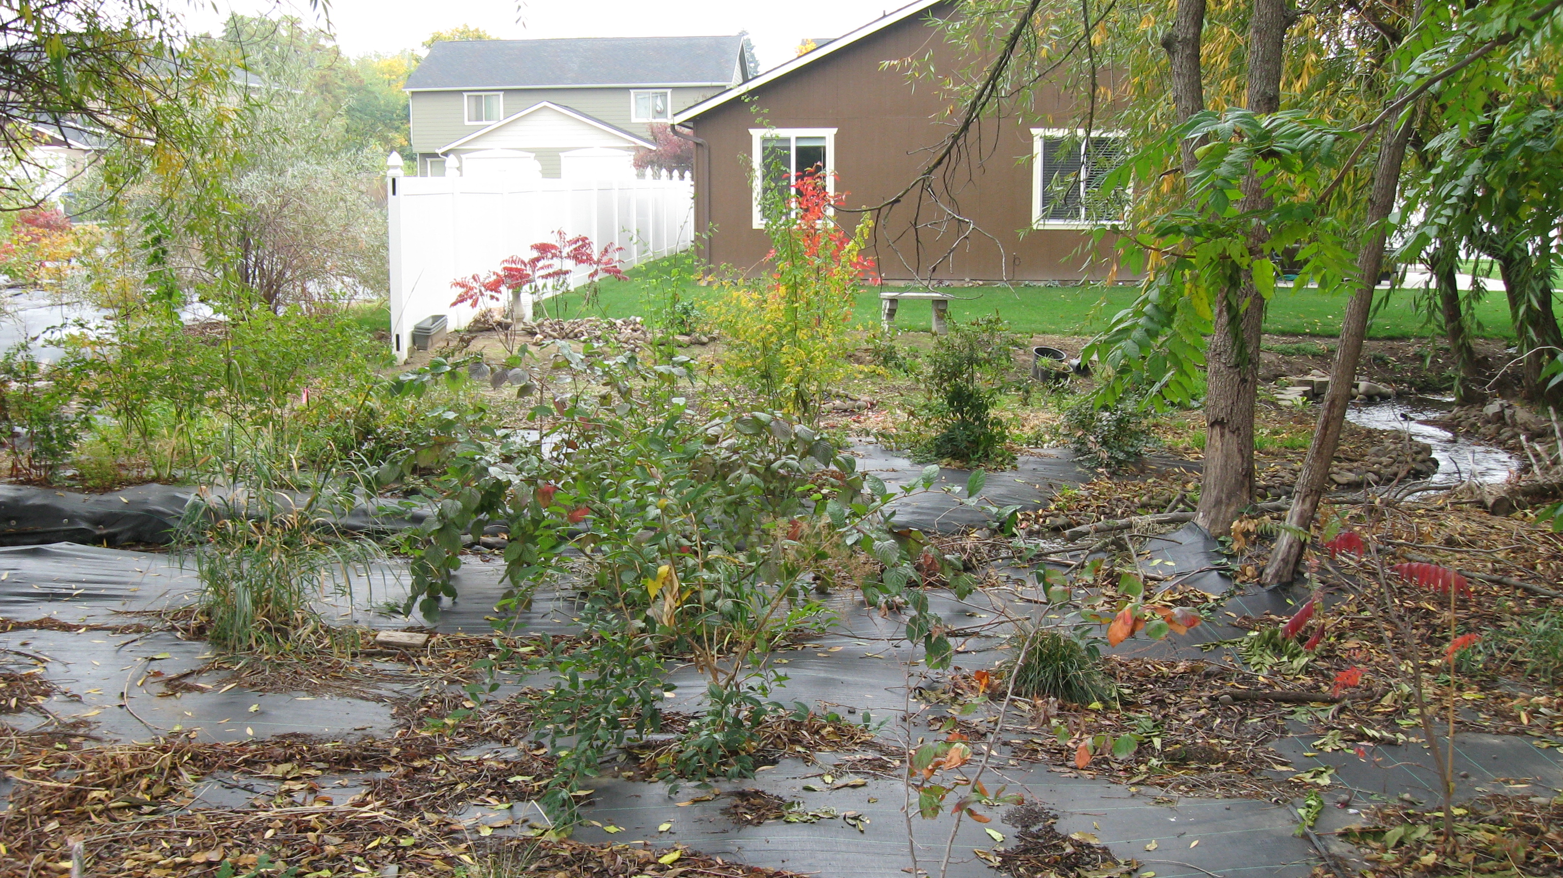
Area 1 After

Slide 16
Garrison Creek Area 2 Before
Garrison A
Area 2 Before

Slide 17
Site Prep Area 2
Garrison A
Area 2 Planting

Slide 18
Planting Garrison 1 area
Garrison A
Area 2 Planting

Slide 19
Planting Area 2 and 3
Garrison A
Area 3 Planting

Slide 20
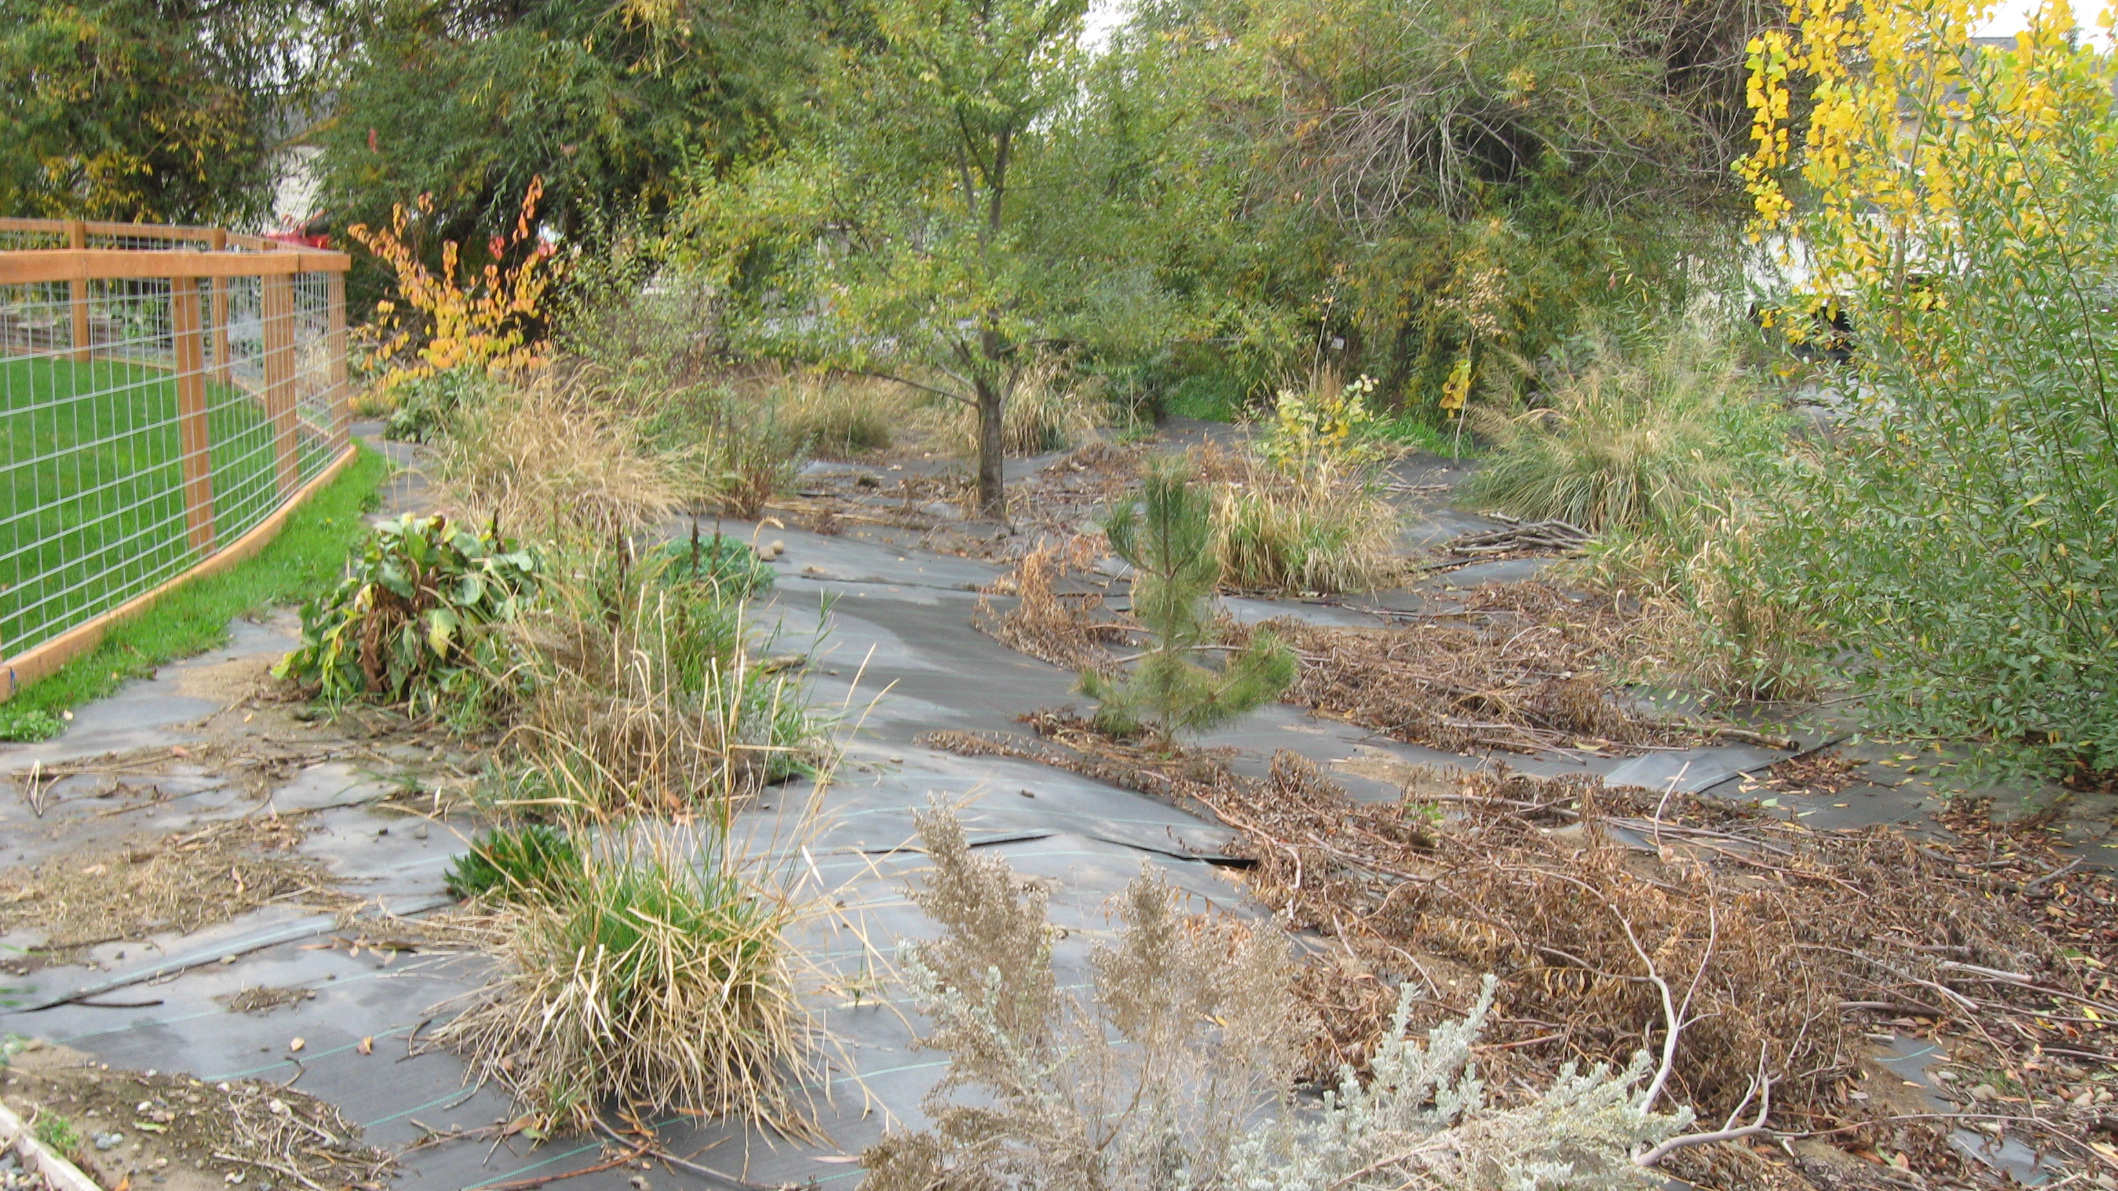
Area 2 After

Slide 21
Area 2 After

Slide 22
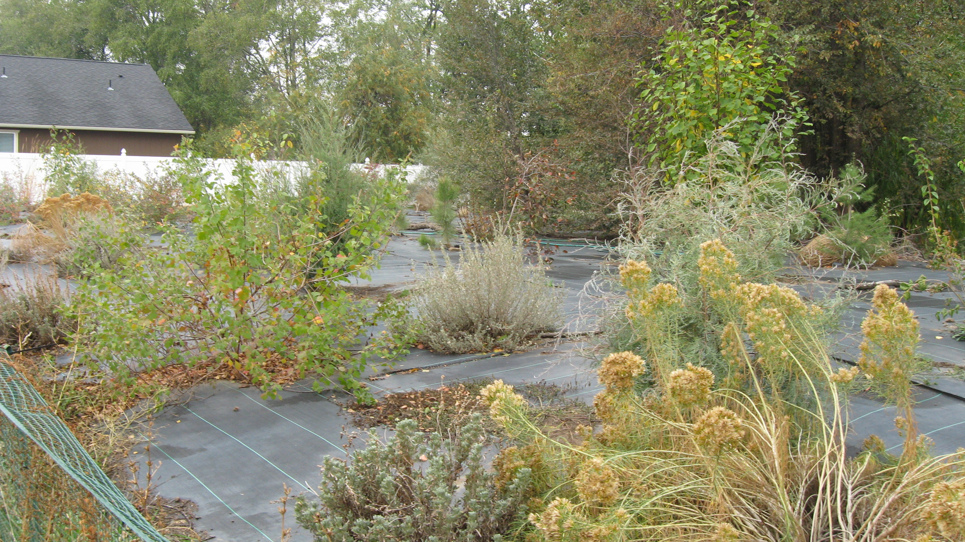
Area 2 After

Slide 23
Garrison Creek Area 3 Before
Garrison A Area 3 Before

Slide 24
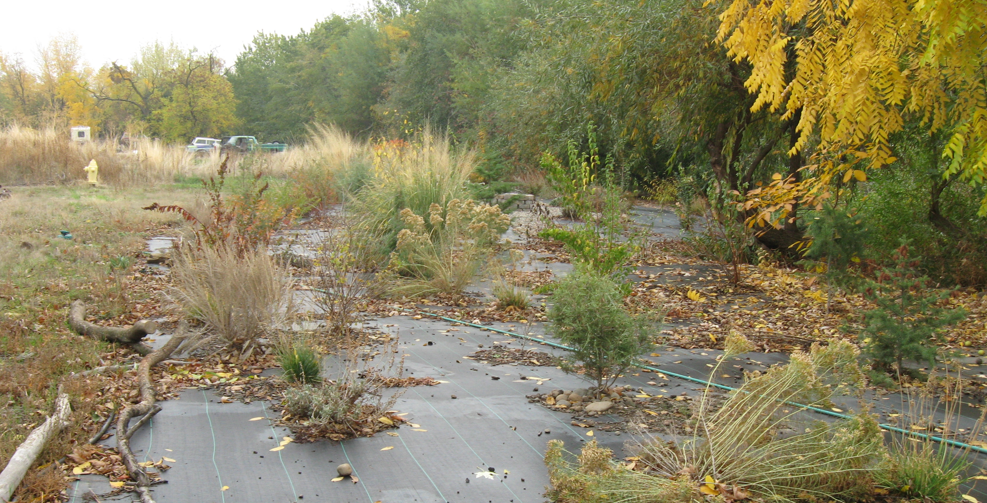
Garrison A
Area 3 After

Slide 25
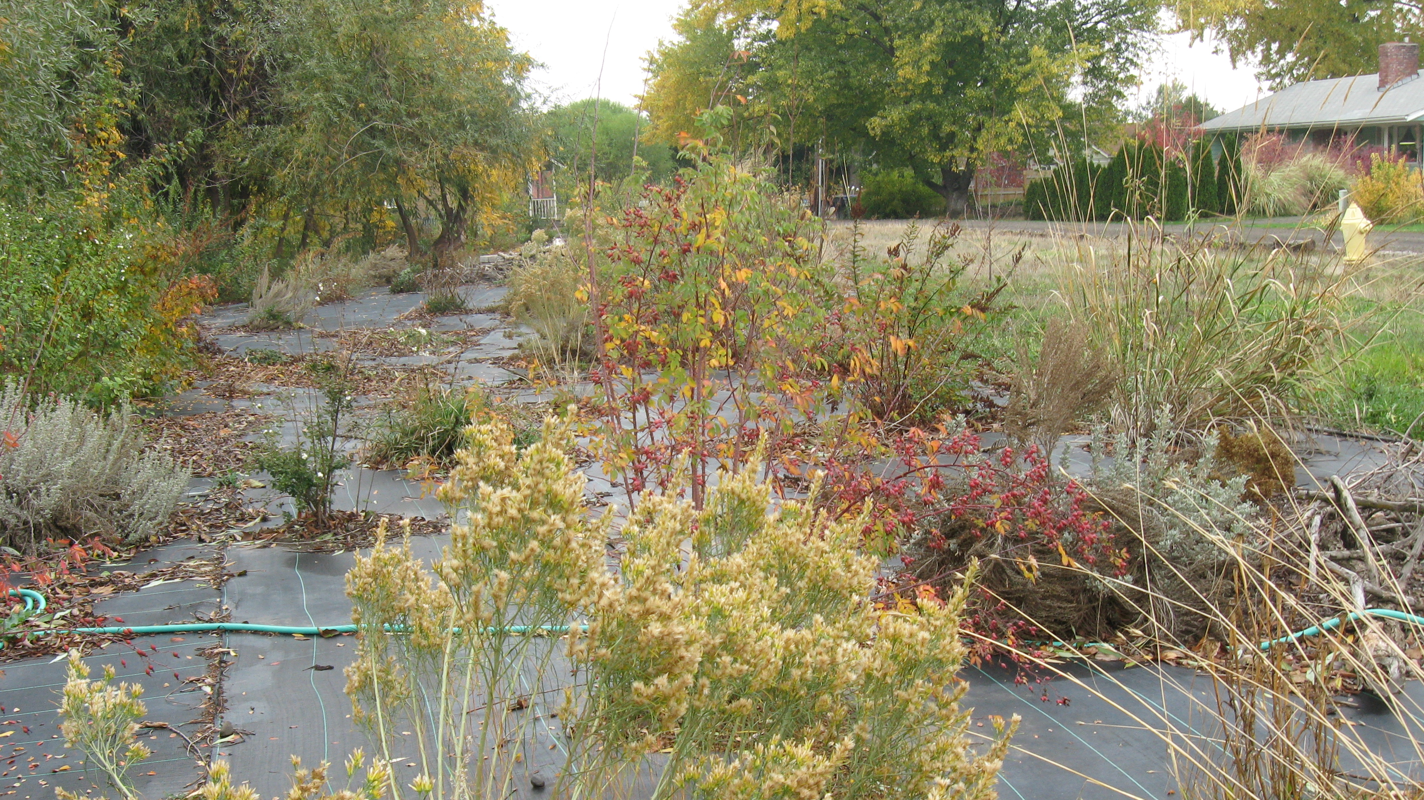
Garrison Area 3 After

Slide 26
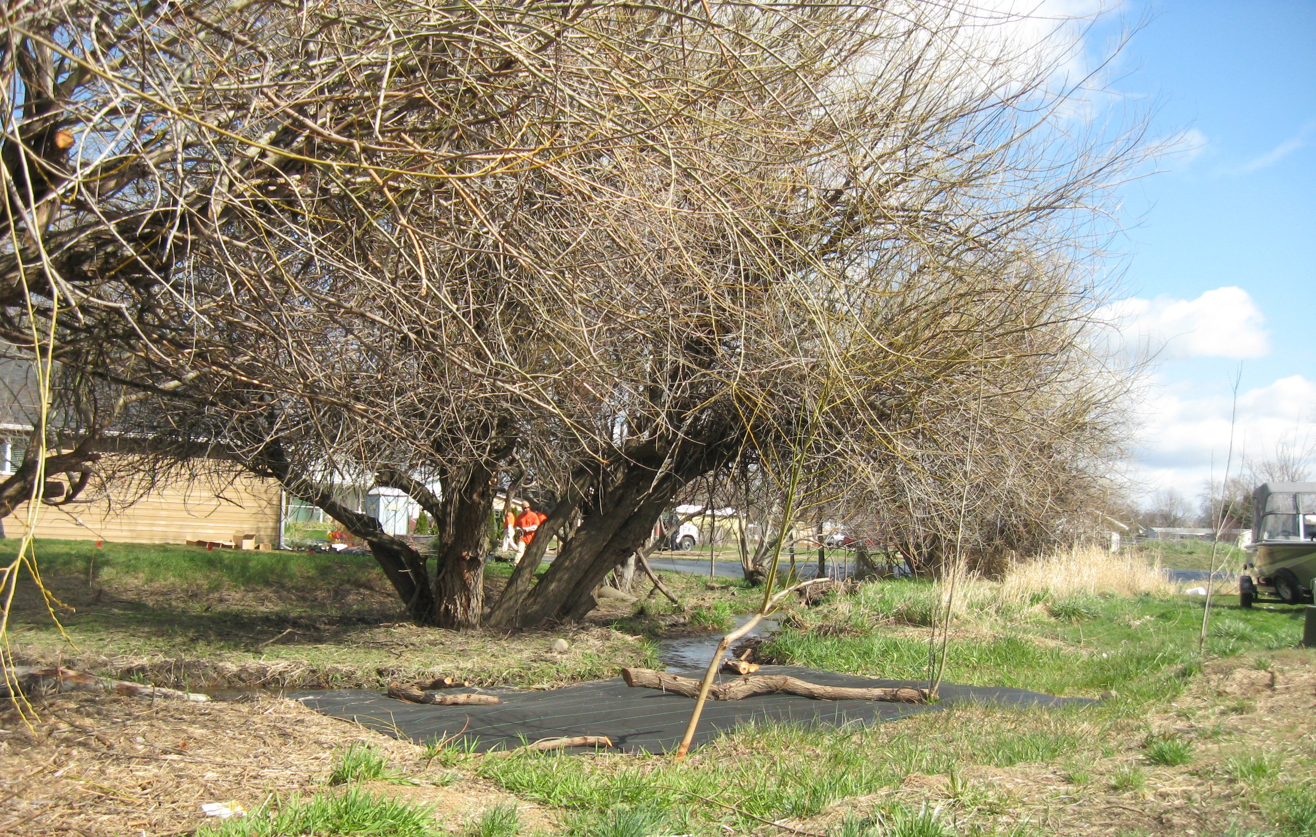
Garrison B Before

Slide 27
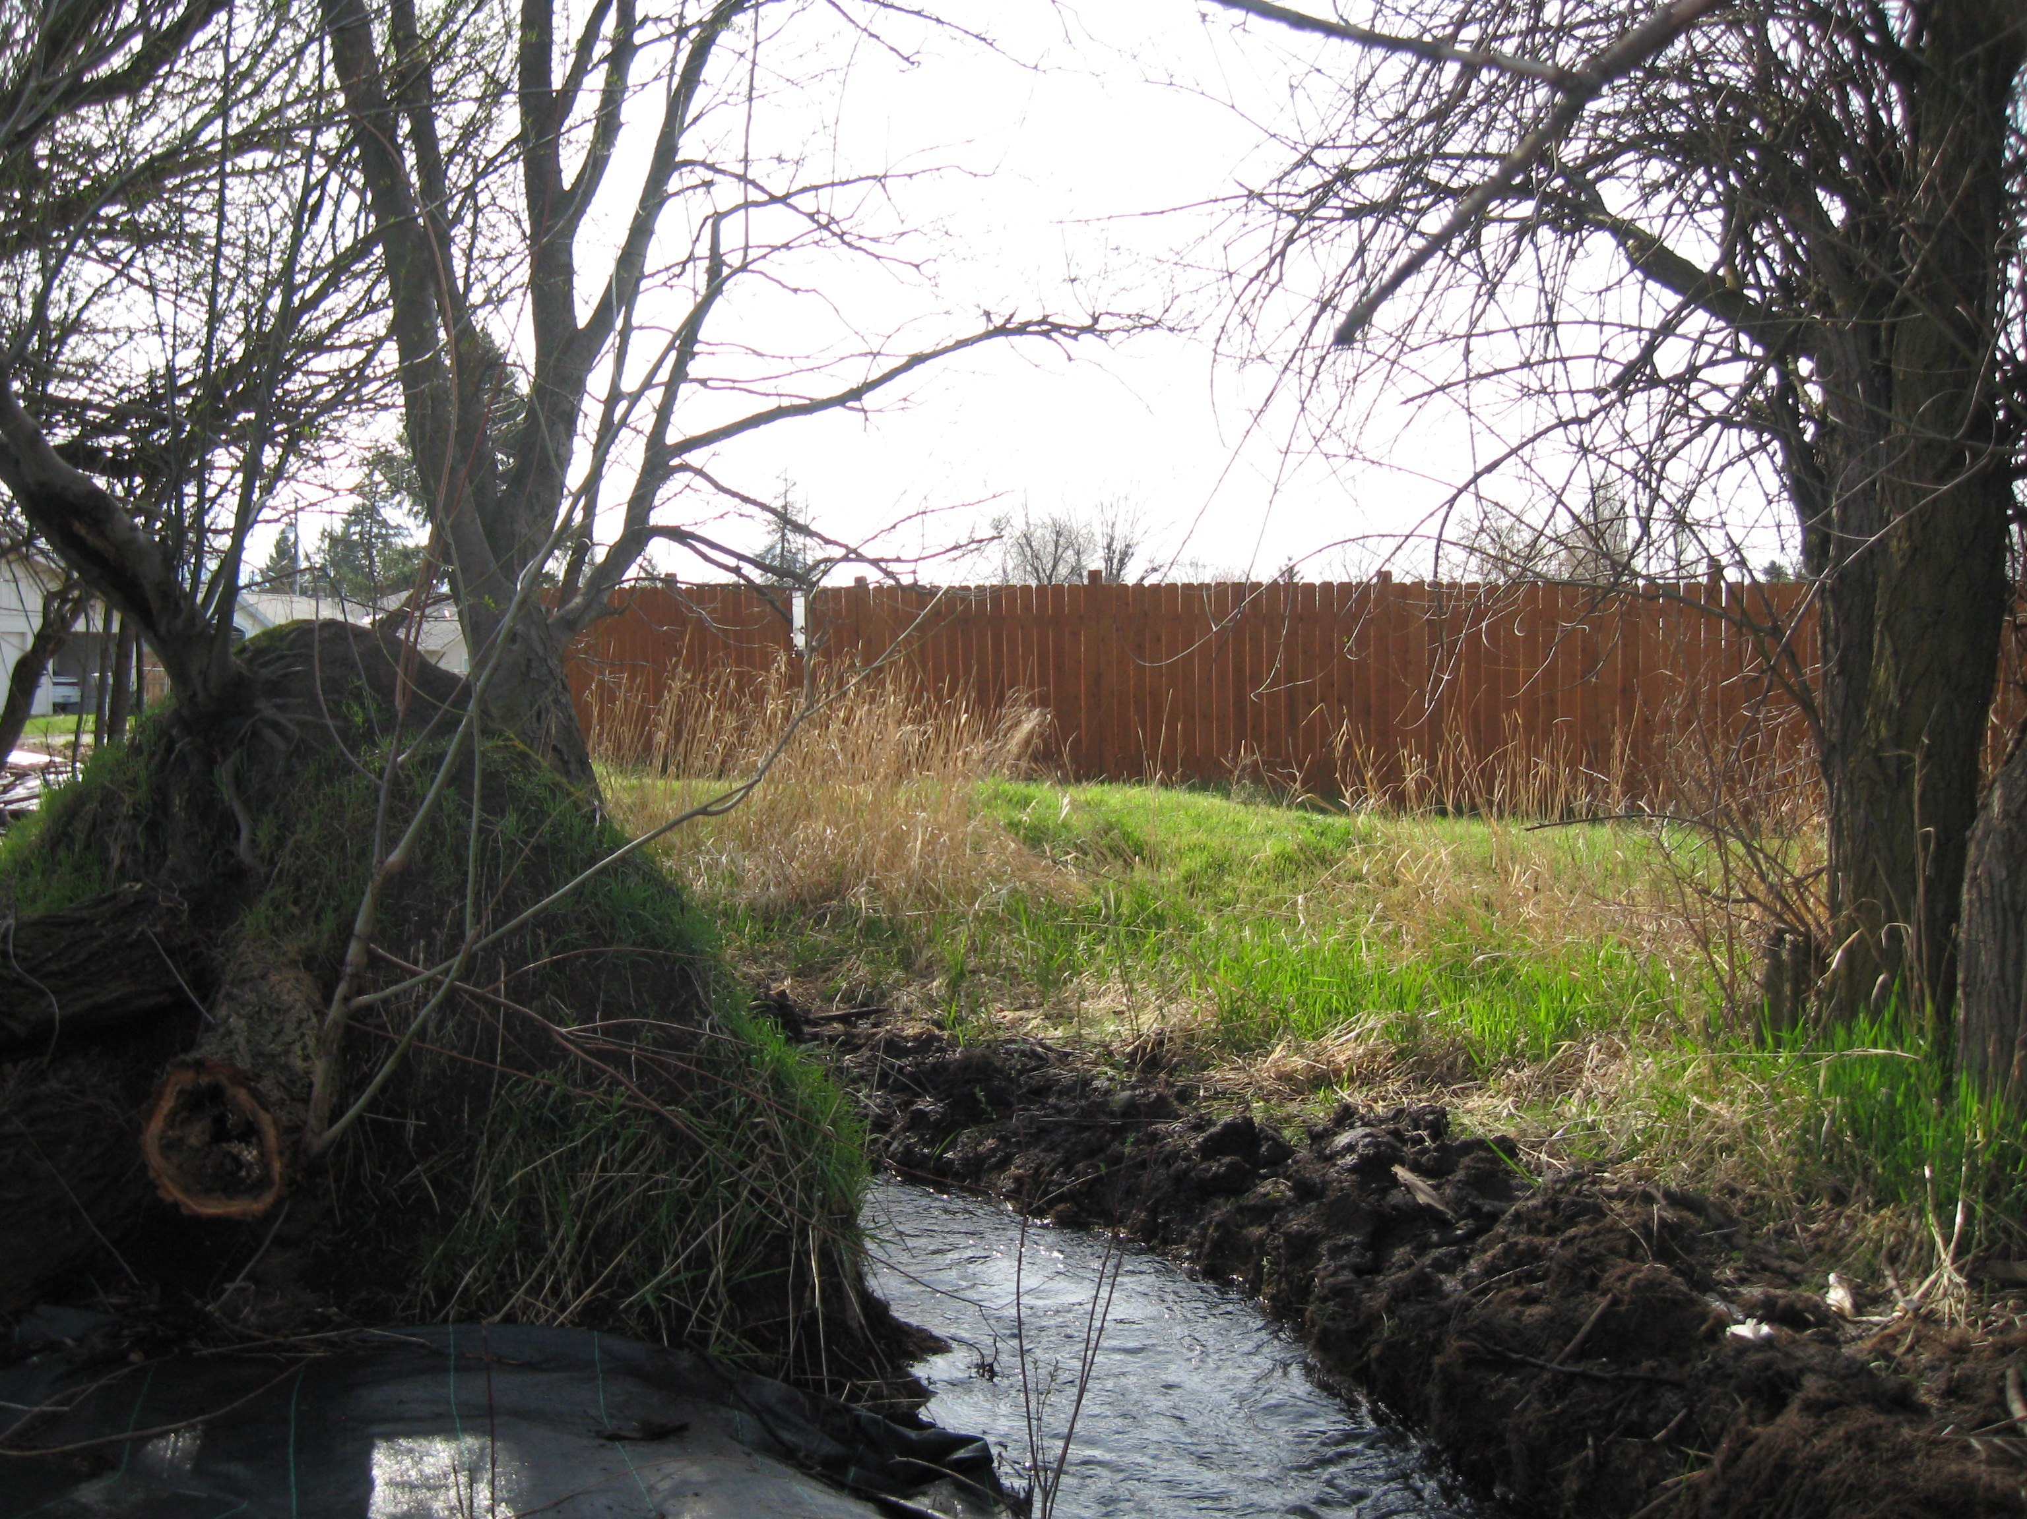
Garrison B Before

Slide 28
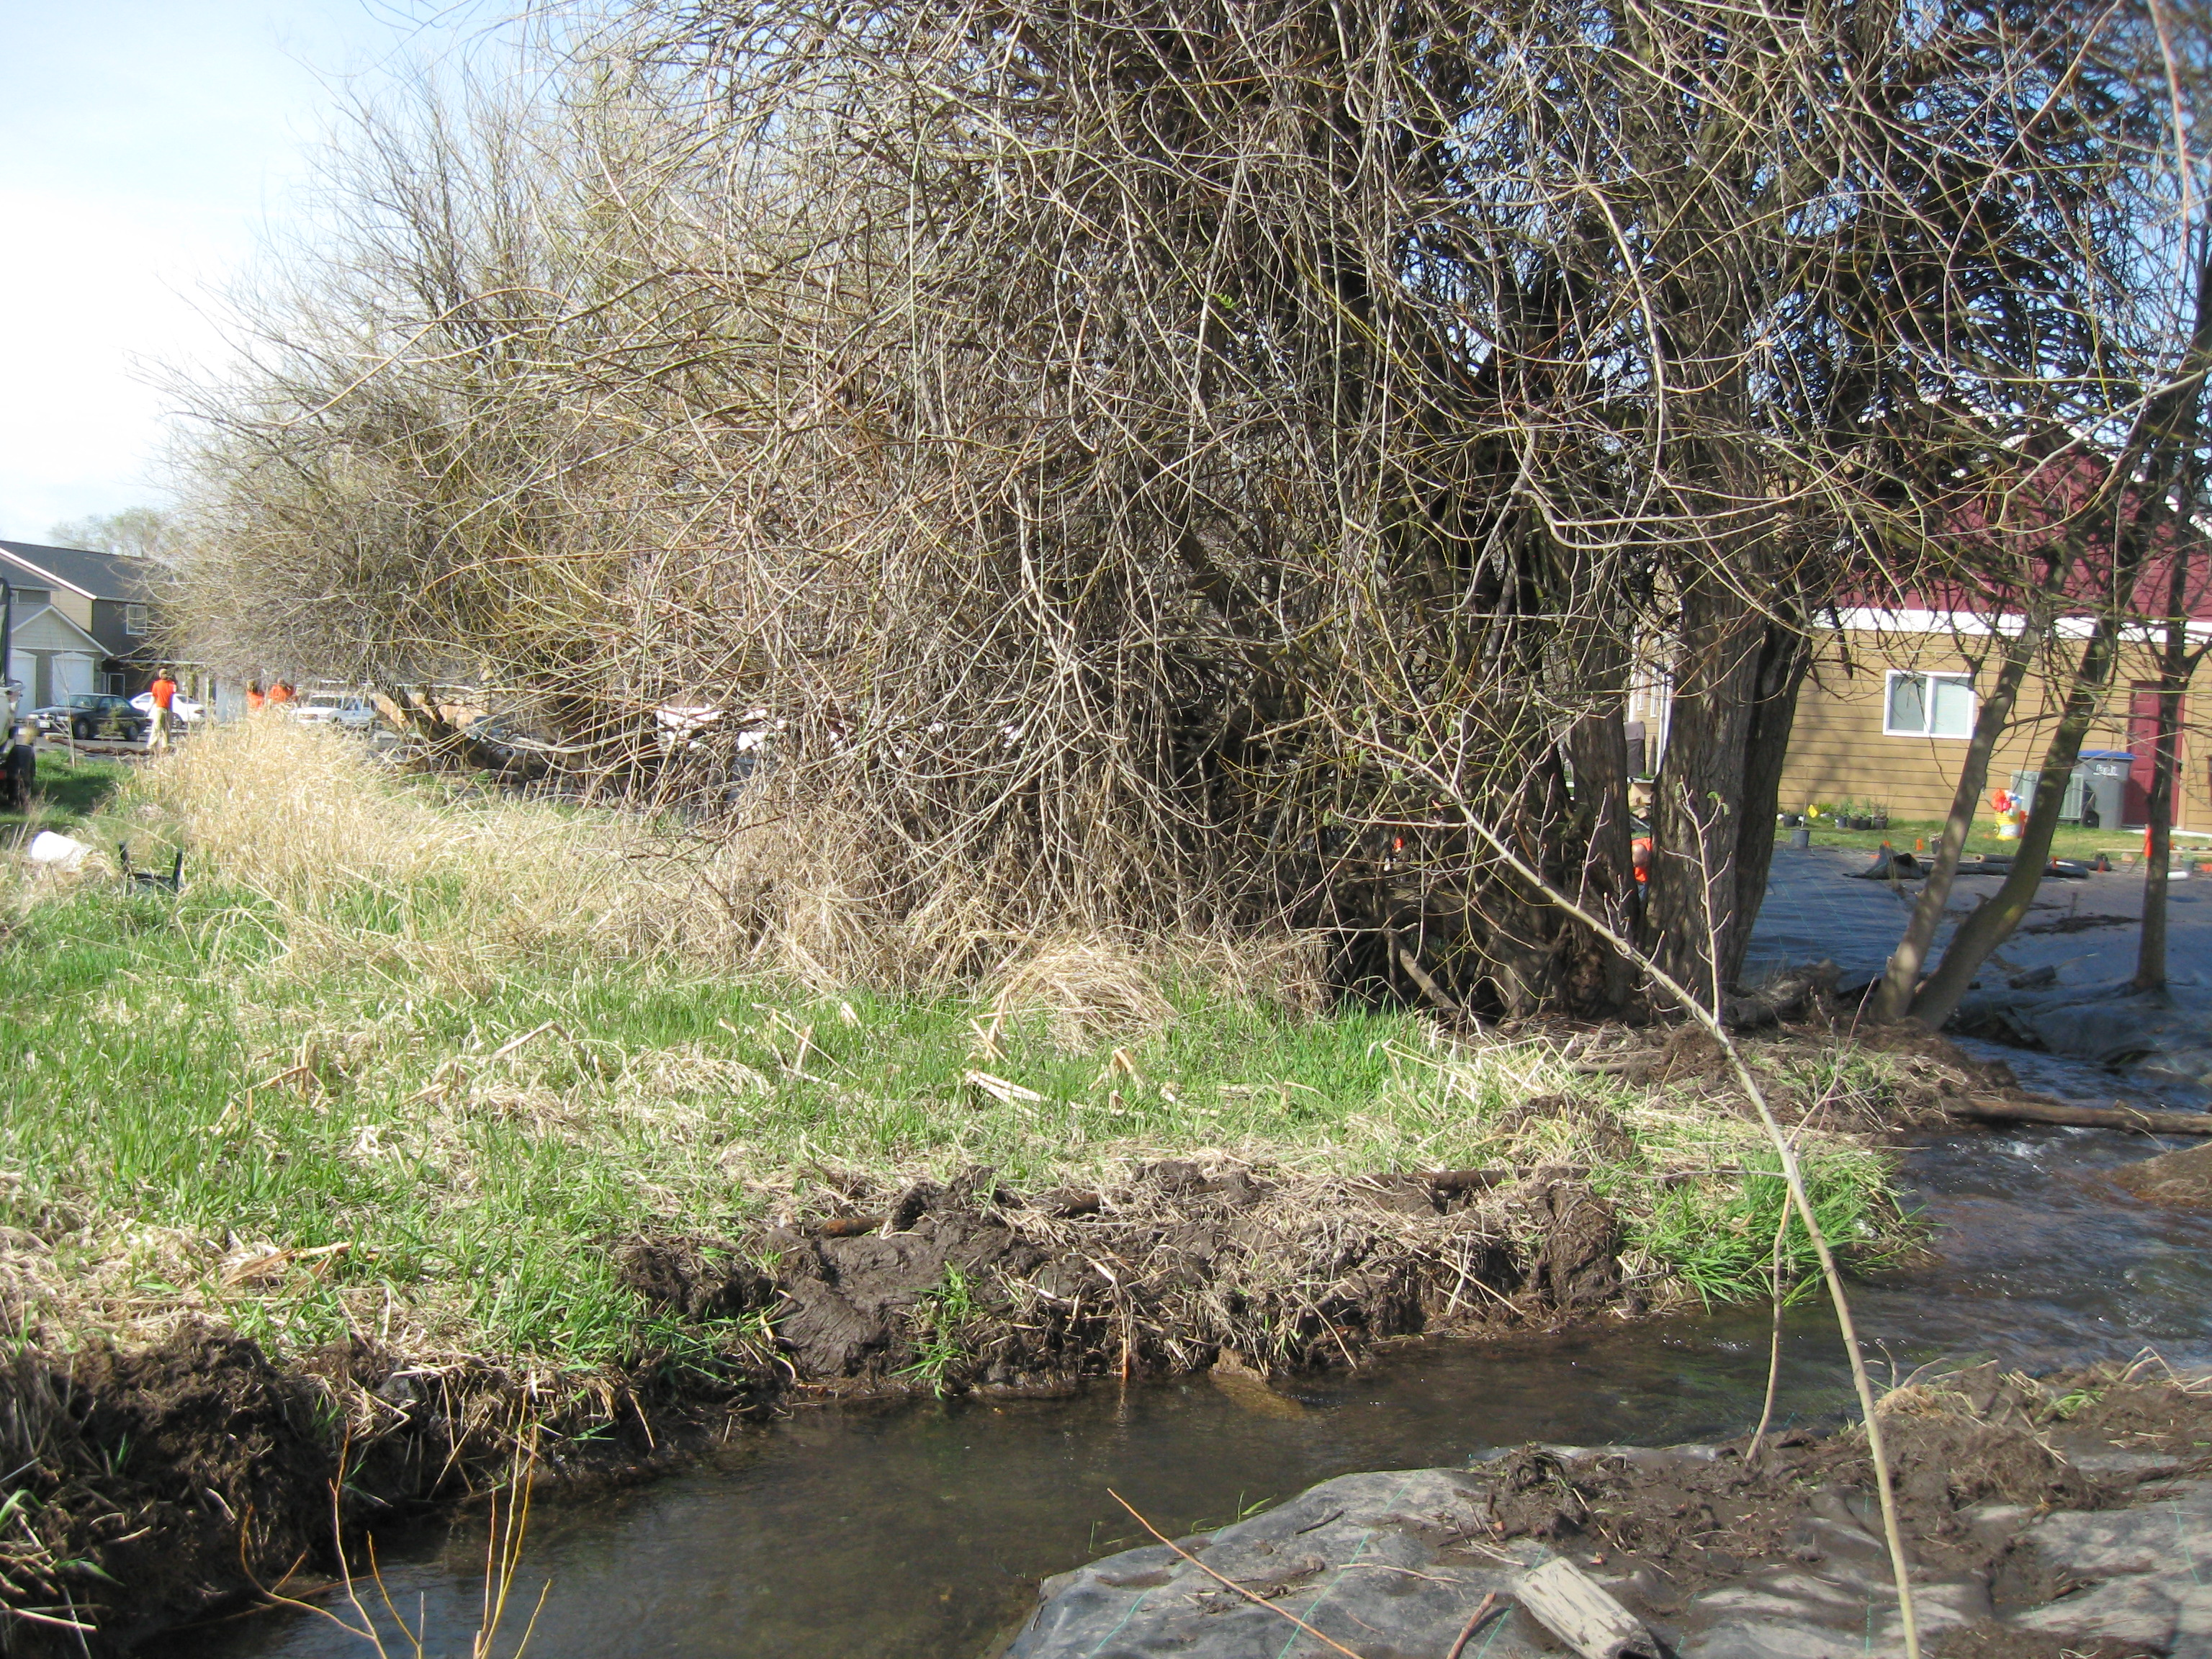
Garrison B Before

Slide 29
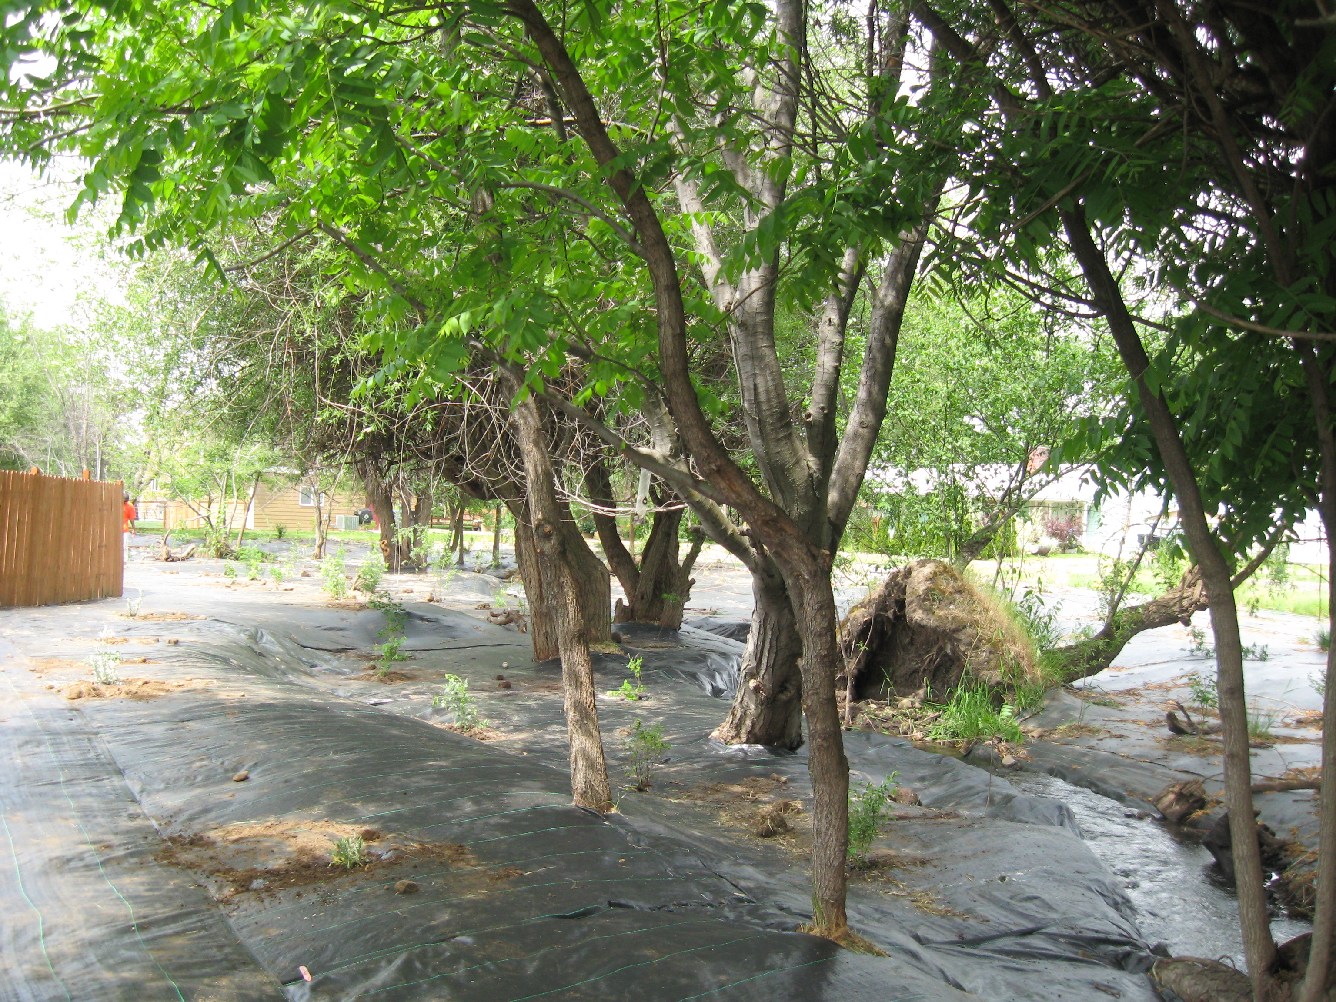
Garrison B
After Planting

Slide 30
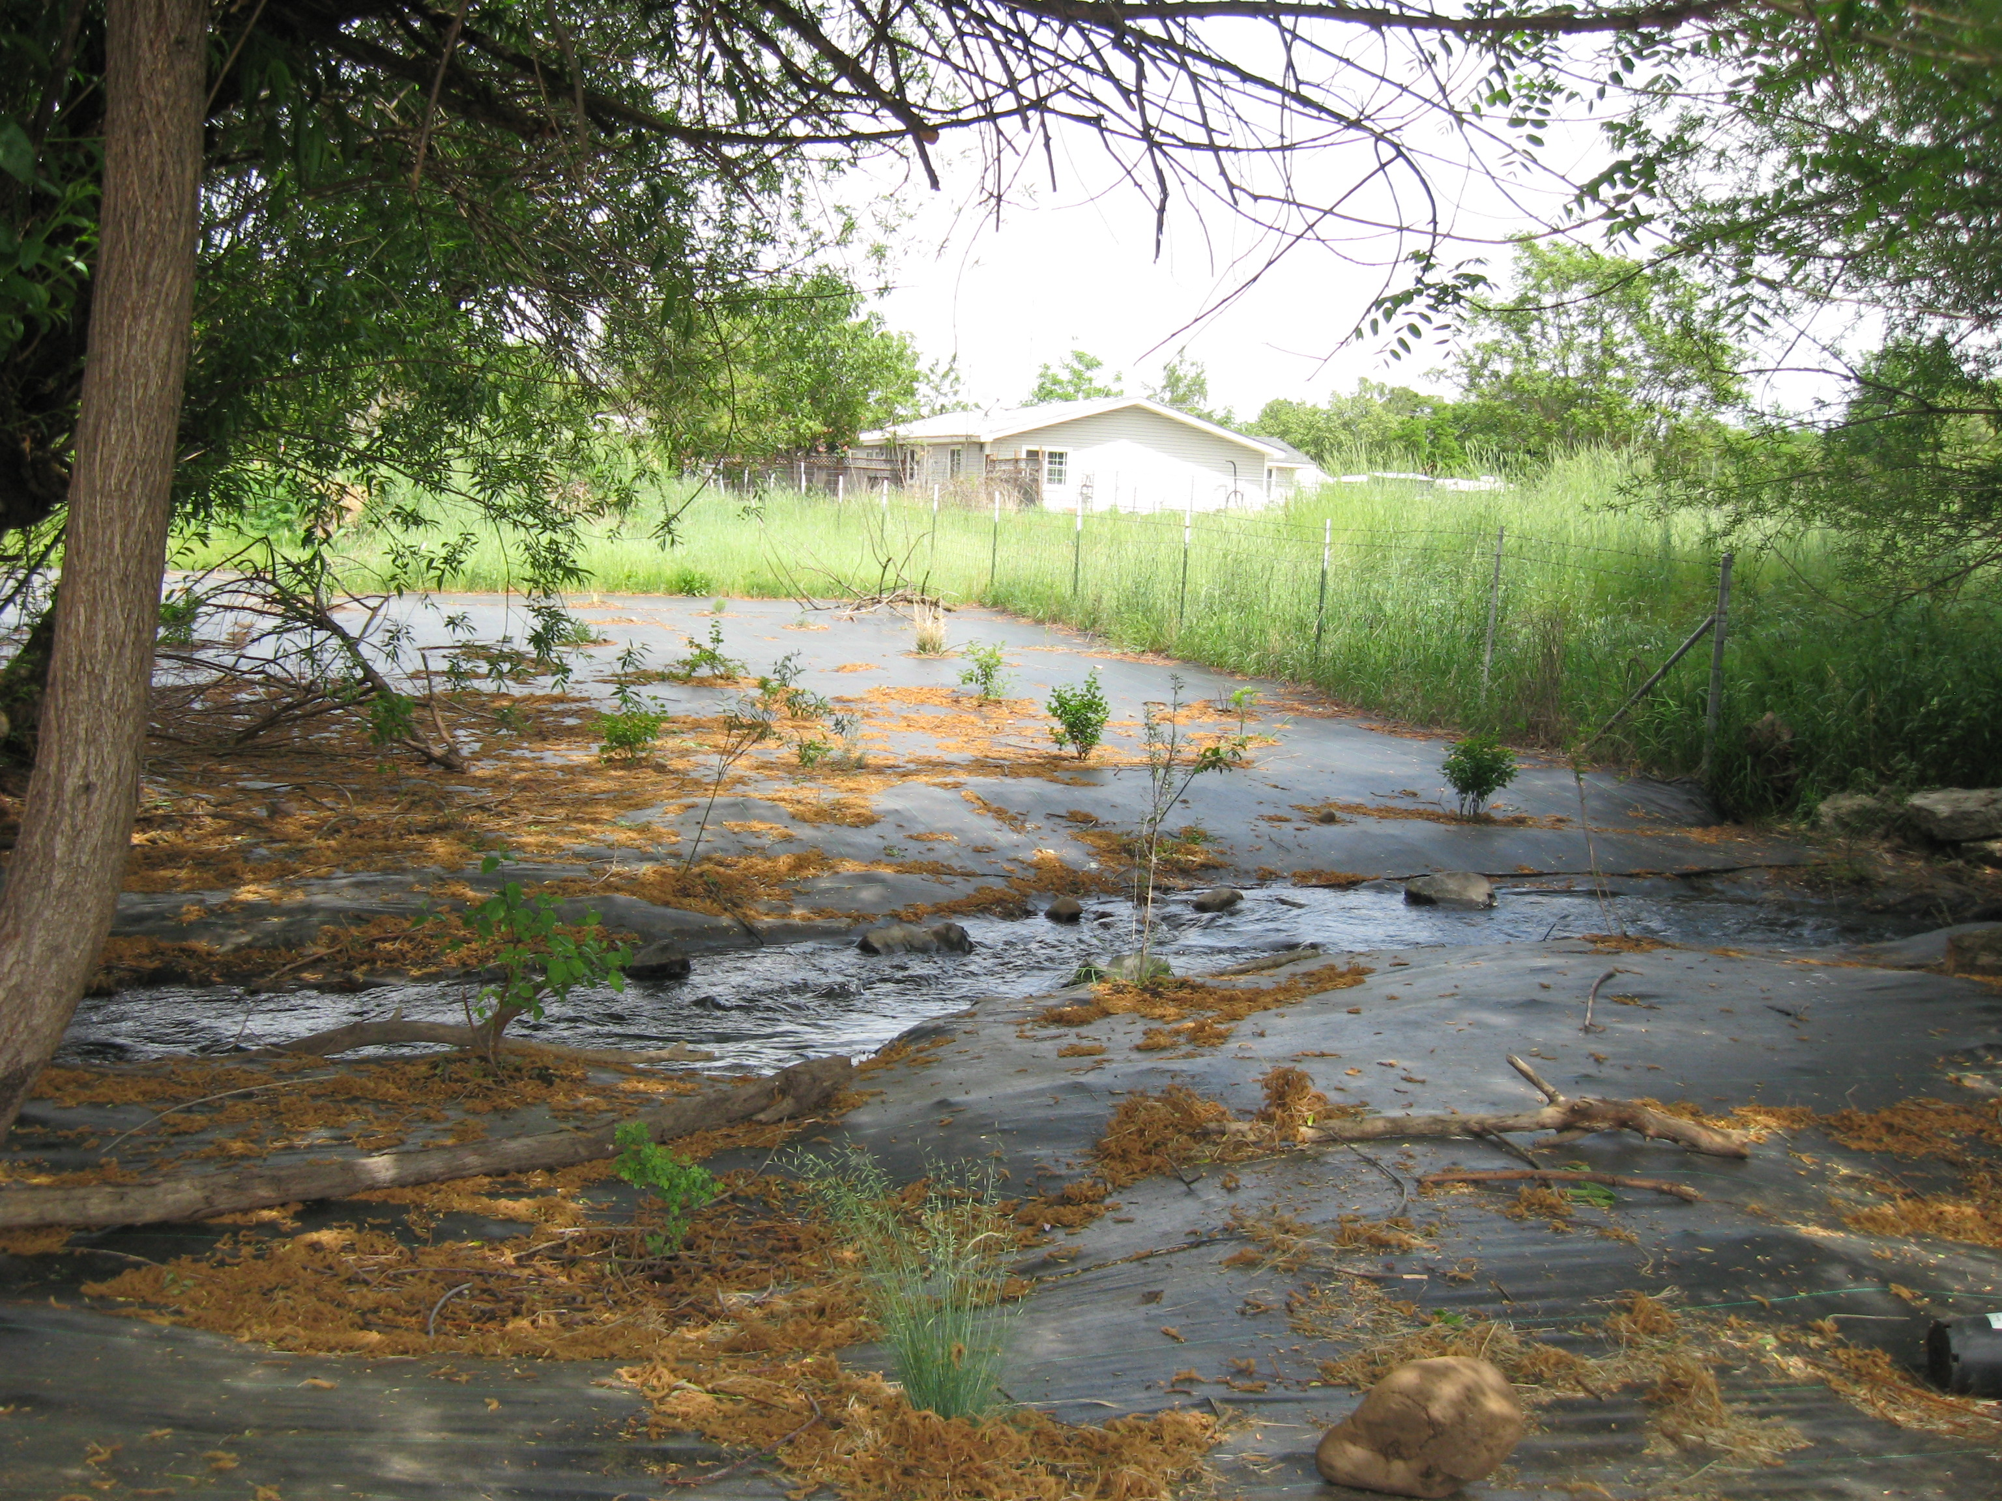
Garrison B After

Slide 31
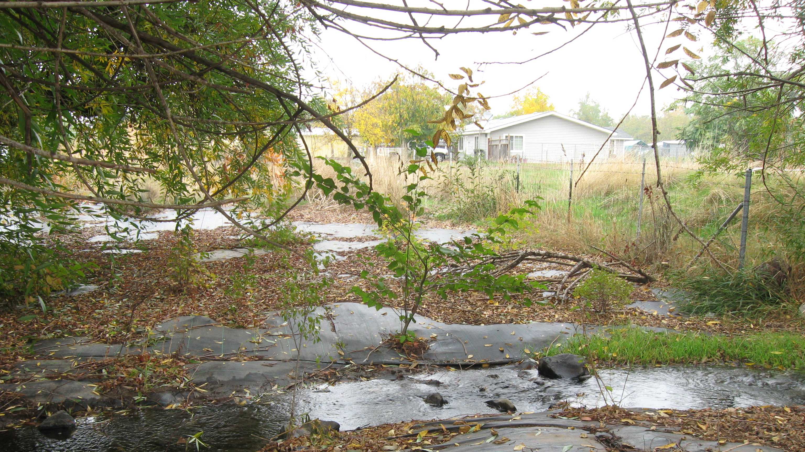
Garrison B After

Slide 32
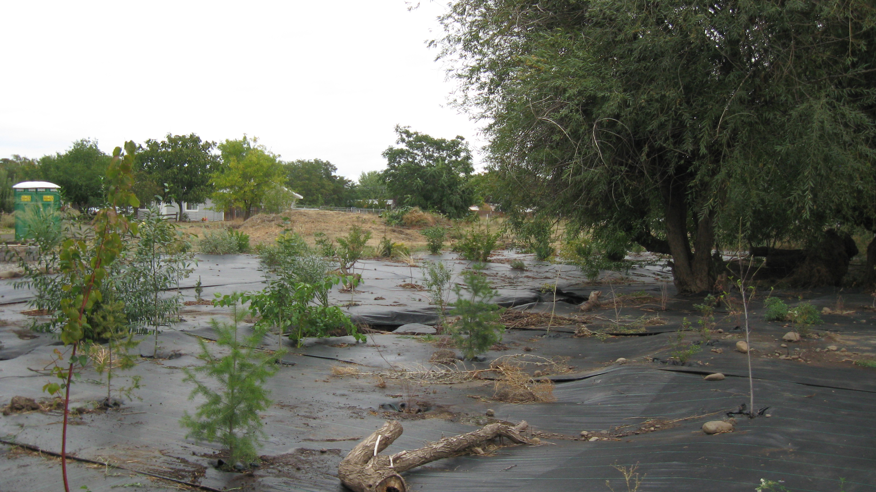
Garrison West A and B After

Slide 33
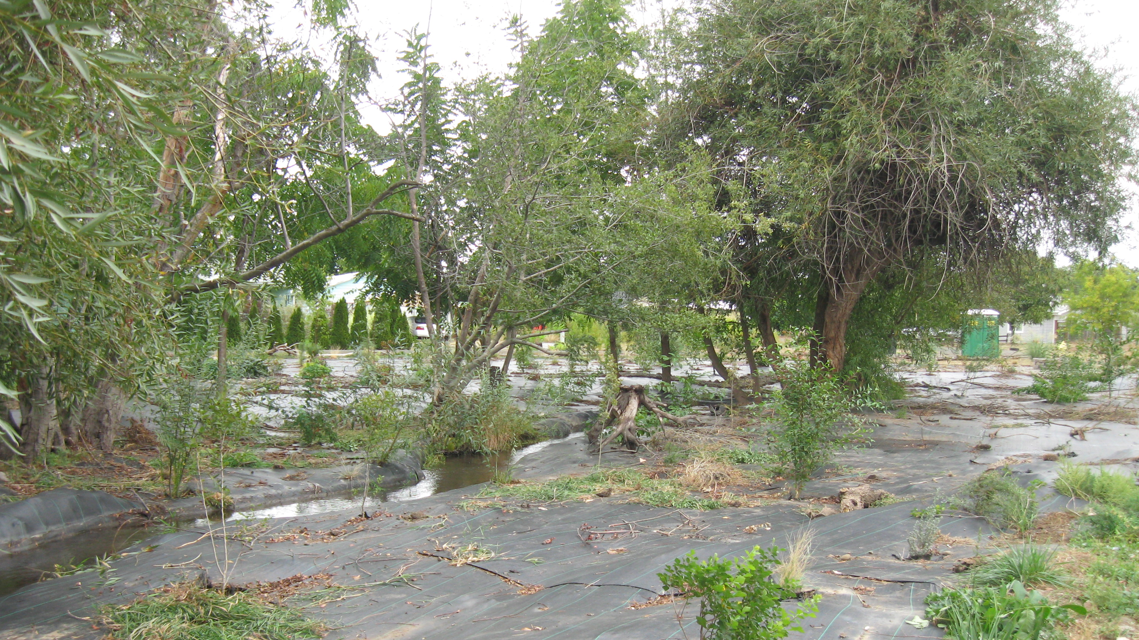
Garrison B After

Slide 34
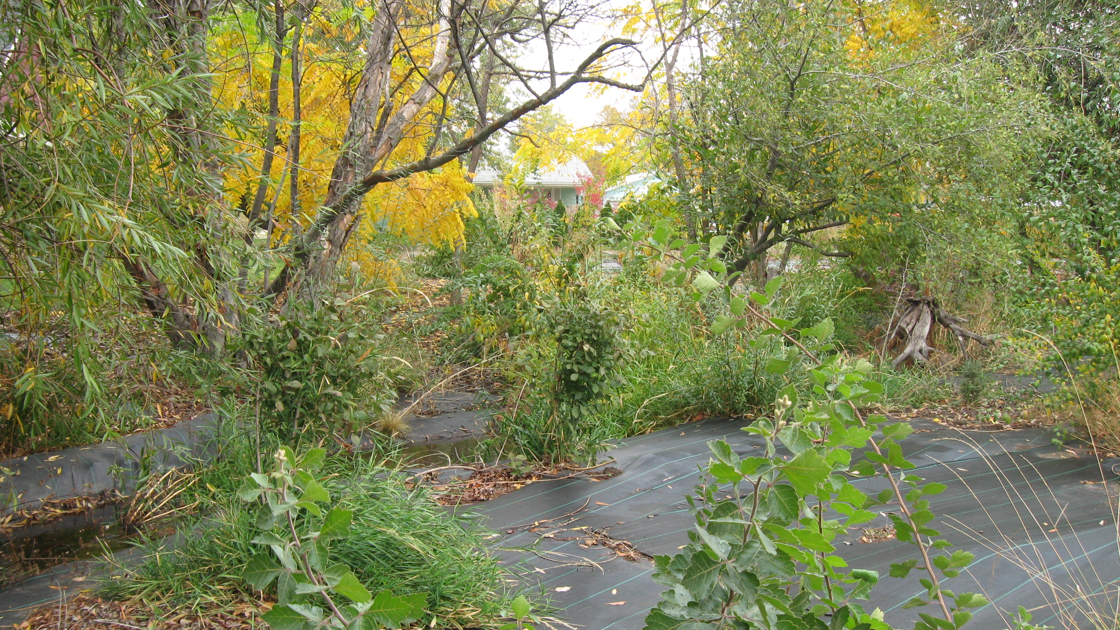
Garrison B After

Slide 35
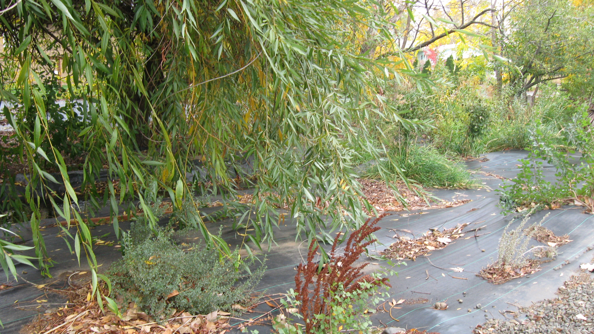
Garrison B After

Slide 36
Garrison Creek Companion Project
Two homes sold at the same time.
Property A owners informed realtor.
Realtor transmitted information to buyer.
Buyer requested minor changes in property riparian area.
Riparian plantings maintained.
Property B did not inform realtor of contract.
New owners removed plantings.
Neighbor reported violations.
City consulted owner/requested replacement of plants/not fined.
Shrubs and trees not replaced.

Slide 37
Problems with monitoring and maintenance of urban riparian buffers when properties change ownership or supervision.
1. Grant provided funding for implementation but not for independent monitoring
2. Landowners often needed assistance with maintaining projects and no funds were available for staff to organize assistance
3. Properties sold without informing new owners of contract to maintain buffers
4. Ecology contract non enforceable
5. City Critical areas violations not noticed or reported
6. Proposal to attach restoration and maintenance to deed

